Slide 1
Physics-Informed Neural Nets
PHYS3211 : Advanced Computational Problem Solving
By: Aidan D’Alonzo

Slide 2
Background
What is a PiNN?
A neural network that incorporates the physical laws of a system,
described by general nonlinear partial differential equations, as
a regularization agent that provides constraints for admissible
solutions when solving supervised learning tasks.
Why are PiNNs useful?
They allow networks to converge to the desired results sooner, and this is helpful because machine learning requires vast amounts of clean training data, which is often sparse or difficult to obtain in practice.
What are the necessary relevant concepts for understanding PiNNs?
Automatic differentiation
A computer’s ability to compute the exact derivative of any function with zero approximation error
Means that a network is differentiable with respect to its inputs, which allows its partial derivatives to be computed exactly by differentiating through the network itself
The back-propagation algorithm
After the input has been fed through the layers and the loss has been calculated, this algorithm takes the derivative of that loss and feeds it backward through the layers, updating each parameter’s weight accordingly
What am I…?

Slide 3
Background (2)
So how do PiNNs work?
They enrich machine learning by plugging the output of the network into the PDE of the physical system being studied and combining the physical residual loss with the data loss into a single total loss function which then gets back-propagated through the layers
A general form for parametrized and nonlinear partial differential equations that can be used is: u(t,x) is a physical quantity that varies with space and time 𝒩[ᐧ; λ] is the nonlinear operator that encodes the spatial physics as parametrized by 𝛌 Ω is a subset of ℝ^{D}
What are the applications?
Forward / Inference
there are fixed parameters 𝛌 and the model predicts u(t,x)
the physics is known and used to find the solution field
Inverse/ Discovery
there is observed data given and the model predicts 𝛌
the observations of the system are known and used to find the underlying physical parameters
Two types of algorithms for computing data-driven solutions to partial differential equations - continuous and discrete time models

Slide 4
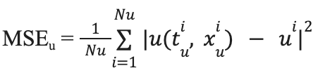
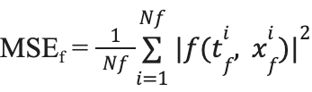
Continuous Time Models
Steps for creating a PiNN:
Input spatio-temporal coordinates and available initial/boundary data.
Approximate u(t,x) using a deep neural network.
This solves for u_{θ}(t,x) ≈ u(t,x) where θ are the network weights
Use automatic differentiation to compute u_{t}, spatial derivatives, and higher derivatives
Build the PDE residual f_{θ}​(t,x) = u_{t} + 𝒩[u_{θ}​] from these computed derivatives
This effectively measures how much the physics is violated, as it is meant to measure zero
Because it uses AD, it has the same network parameters as u_{θ}(t,x)
Evaluate f_{θ}​(t,x) at collocation points and force u_{t} + 𝒩[u_{θ}​] ≈ 0.
Collocation points are random points in space-time where there might not be data, but physics still must hold
Compute and minimize the mean squared error loss using MSE = MSE_{u} + MSE_{f} .
MSE_{u} makes the network match with initial and boundary conditions, accounting for data loss
MSE_{f} makes the network match with the structure imposed by the PDE, accounting for physics loss
Backpropagate the joint loss.
The NN gets better at fitting to the observed data and the underlying physics

Slide 5
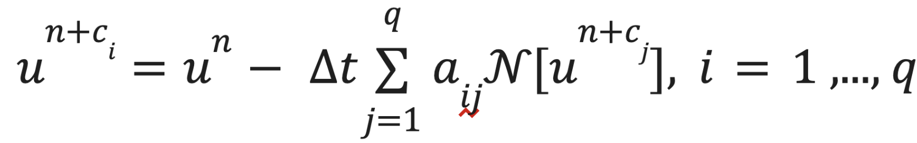
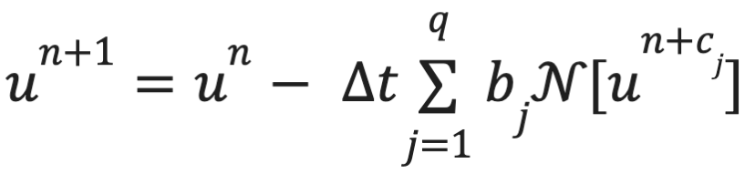
Discrete Time Models
Discrete time models step forward in time using the Runge-Kutta method
(Instead of solving the PDEs continuously across all time as in continuous models)
Thus, intermediate stages are created inside the timestep:
The parameters (a_{ij}, b_{j}) are simply the RK coefficients
: each intermediate state equals the previous state minus the timestep multiplied by the weighted combination of physics evaluations
: the final update of the next time step is computed using a weighted sum of the stage derivatives
The model simultaneously outputs u(t,x) at each of the q intermediate RK stages and at the final next timestep.
It computes the loss from the deviation between the NN predictions and the values required by the time-stepping scheme, which is then back propagated
In Comparison to Continuous Time Models:
Learns the constraints of the PDE not by minimizing a residual, but by satisfying the structure of a physics-based time-stepping algorithm
Is preferable for rapidly changing solutions or long time horizon solutions

Slide 6
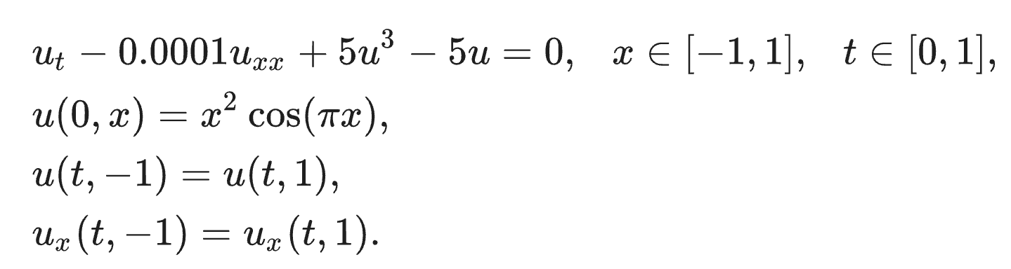
The Allen-Cahn Equation
The Allen-Cahn equation is a fundamental reaction-diffusion PDE that is useful for modeling phase separation in multi-component systems
i.e. the dynamic boundary between water and oil in a container that has been shaken
An example:
The u_{xx} term is the diffusion term of the equation and the 5u³ - 5u term is the nonlinear reaction term; the former smooths out the interface while the latter sharpens it and drives it toward 土1 equilibrium phases.
Why is this classically challenging?
the reaction term is highly nonlinear and changes very rapidly near the interface, thus requiring very small timesteps or else the solver overshoots
How does a PiNN help?
the network predicts the solution at all Runge–Kutta stages simultaneously, with shared parameters, and then penalizes any solution that does not satisfy the RK equations
Thus, by having the RK scheme implicit in the network’s structure, it is able to take larger timesteps and still be effective without the overshoot worry

Slide 7
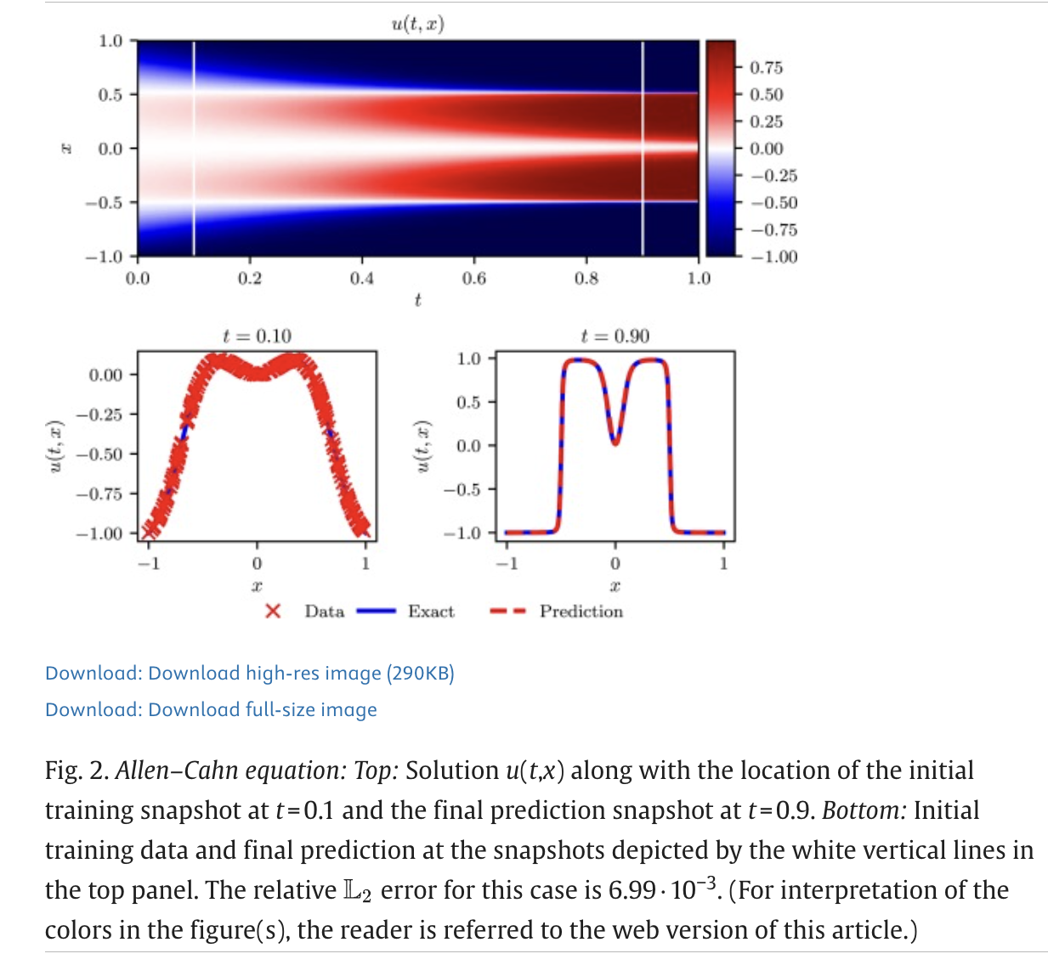

The Allen-Cahn Equation (2)
In the referenced paper, they test the PiNN on training data generated by running a conventional spectral method simulation:
Heatmap of the true solution u(t,x) of the Allen-Cahn PDE
the interface narrows as the competing effects of diffusion and nonlinear reaction drive phase separation
Left: training snapshot at t=0.1
(what the PiNN was fed)
Right: prediction snapshot at t=0.9
(the solution the PiNN output)
Relative error: 0.00699

Slide 8
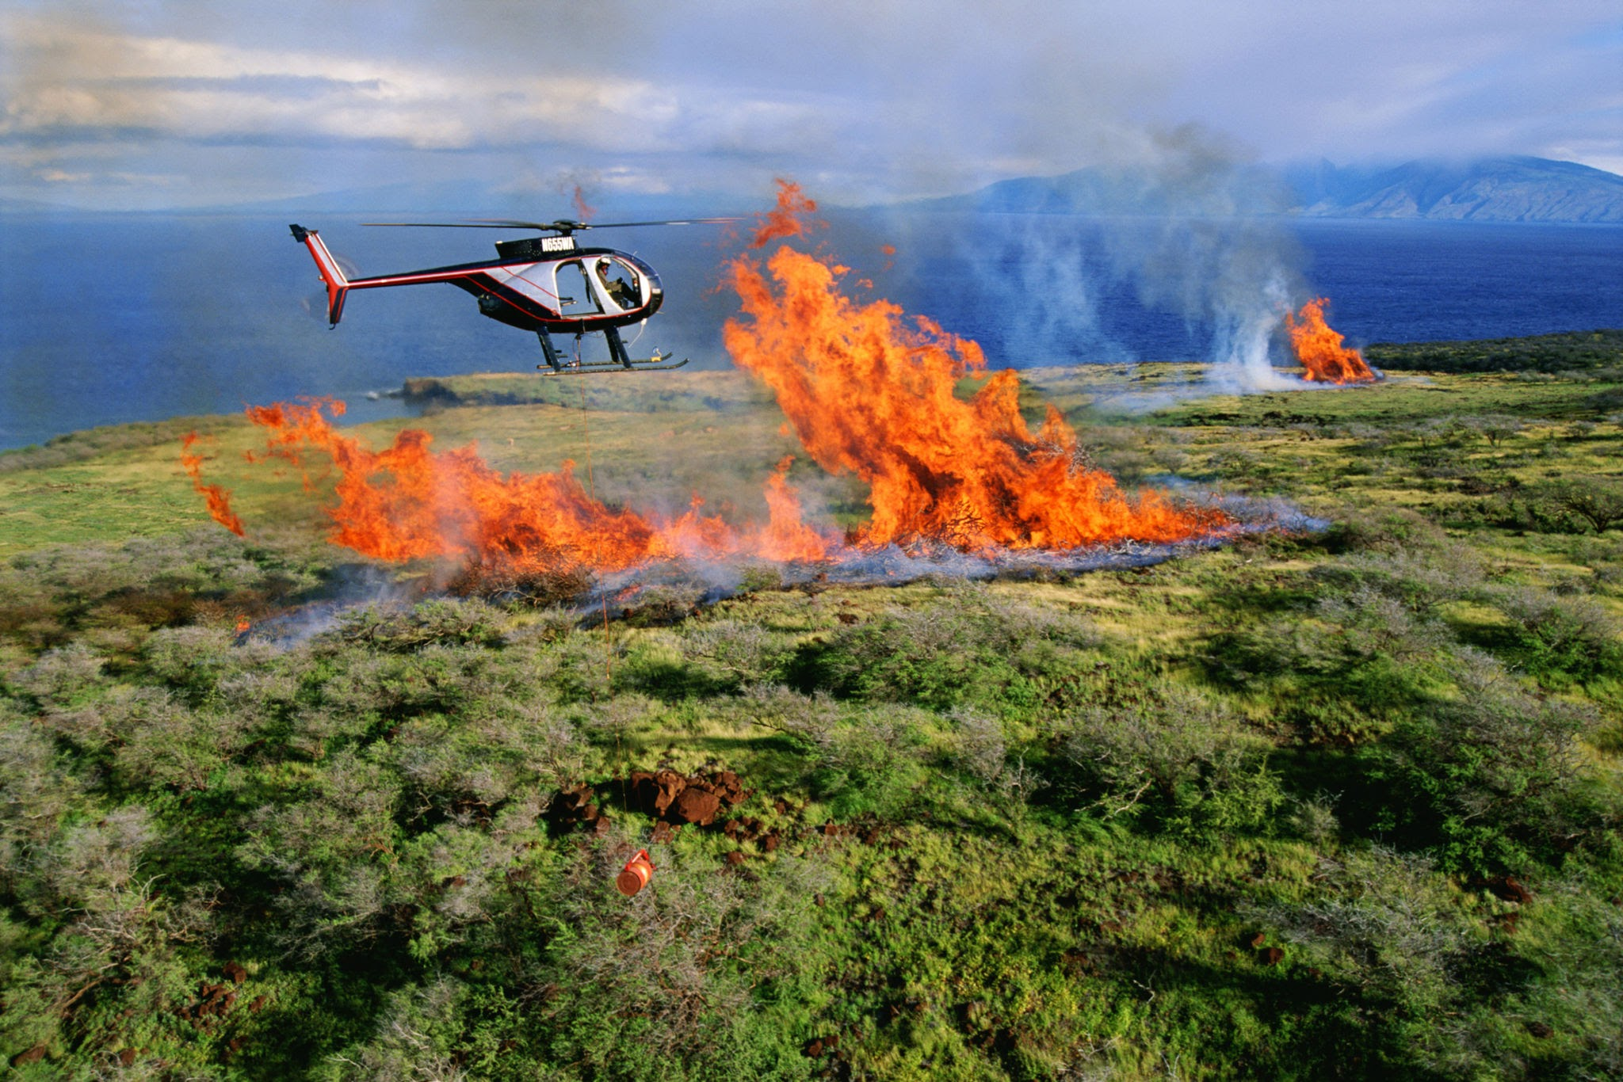
Wildfire Application
My Wildfire Modeling Capstone
aims to predict whether a given pixel will be on fire in the next hour using a NN
Wildfire satellite data is sparse (limited labeled measurements, significant gaps between passes)
Could result in problems like fire teleportation, instantaneous large jumps, etc.
How could a PiNN help?
Fill in data gaps by sampling collocation points and constraining its solution to a governing PDE
Potential for the Allen-Cahn equation as an approximation for fire front propagation
The diffusion term could encode how heat spreads outward through unburned fuel (so solution has to be spatially smooth)
The nonlinear reaction term could drive pixels toward two stable states of either burned (+1) or unburned (-1) (if a pixel reaches burned state it stays there)
Prevent the NN from producing predictions that violate basic fire behavior

Slide 9
Thank you
Reference
Raissi, M., Perdikaris, P., & Karniadakis, G. E. (2019). Physics-informed Neural Networks: A deep learning framework for solving forward and inverse problems involving nonlinear partial differential equations. Journal of Computational Physics, 378, 686–707. https://doi.org/10.1016/j.jcp.2018.10.045

